Slide 1
Bank Transaction Fraud Detector
Name: Shreyas Yadav
Email: shreyas_2312res897@iitp.ac.in
Course: Data Science Project

Slide 2
Problem Statement
Banking institutions deal with millions of transactions daily.
Fraudulent transactions cause major financial losses.
Manual detection is slow and unreliable.
Need: An automated machine learning system for fraud detection.

Slide 3
Objectives
• Detect fraudulent transactions automatically.
• Apply machine learning classification techniques.
• Provide real-time prediction through Streamlit.
• Protect banks and customers from losses.

Slide 4
Dataset
Features:
- TransactionID
- Amount
- Type (ATM, Card, Online, Bank Transfer)
- Location (Delhi, Mumbai, Chennai, Kolkata, Bangalore, Unknown)
Target:
- Is Fraud (0 = Legitimate, 1 = Fraud)
Size: 500 records (synthetic dataset).
Fraud Ratio: ~27% Fraudulent, ~73% Legitimate.

Slide 5
Methodology
1. Import and preprocess transaction data.
2. Encode categorical variables (Type, Location).
3. Scale numerical features (Amount).
4. Train-Test Split (70-30).
5. Model Training using Logistic Regression.
6. Model Evaluation using Accuracy, Confusion Matrix.
7. Real-time Prediction using Streamlit.

Slide 6
Model Evaluation
• Accuracy ~ 80%
• Metrics:
- Precision, Recall, F1-Score
• Confusion Matrix visualization
• Fraud vs Non-Fraud prediction performance.

Slide 7
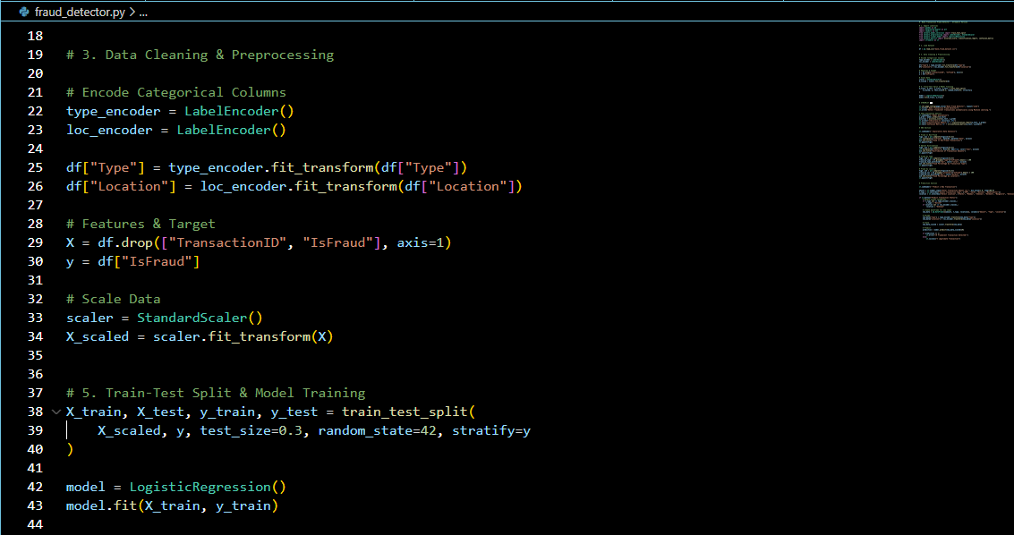

Slide 8
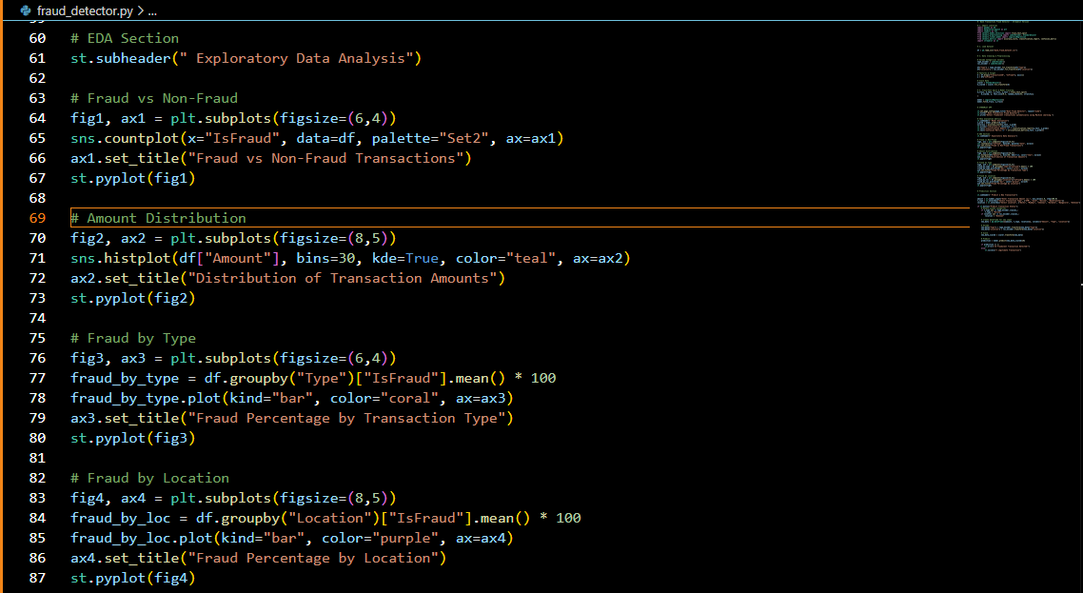
Exploratory Data Analysis (EDA)
Code for Exploratory Data Analysis (EDA): Generates graphs for fraud distribution, amount distribution, transaction type, and location.

Slide 9
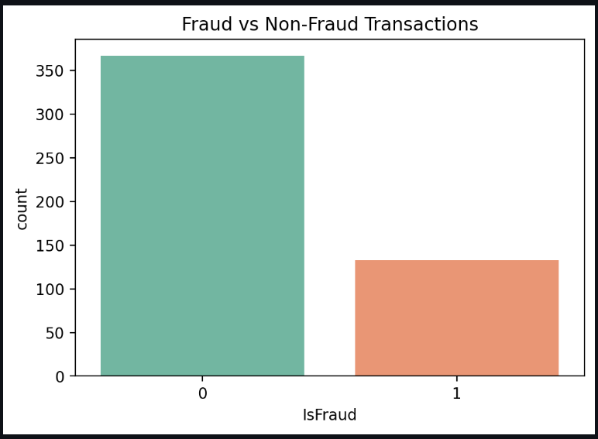
Fraud vs Non-Fraud Count: Shows the imbalance between fraudulent and legitimate transactions.
X-axis: 0 = Legitimate, 1 = Fraud | Y-axis: Count of transactions

Slide 10
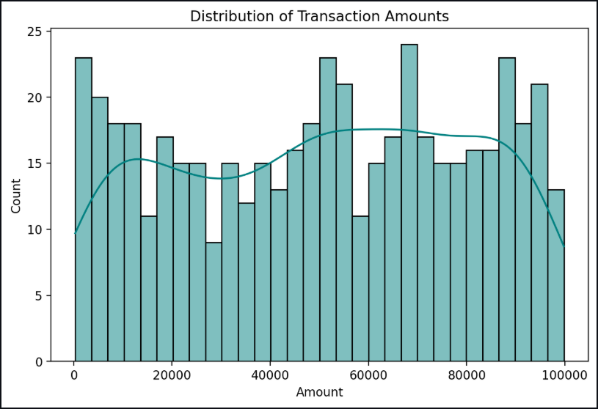
Distribution of Transaction Amounts: Most transactions are small amounts, but large ones are more likely to be fraud.
X-axis: Transaction Amount (₹), Y-axis: Number of Transactions – shows how amounts are distributed across all transactions.

Slide 11
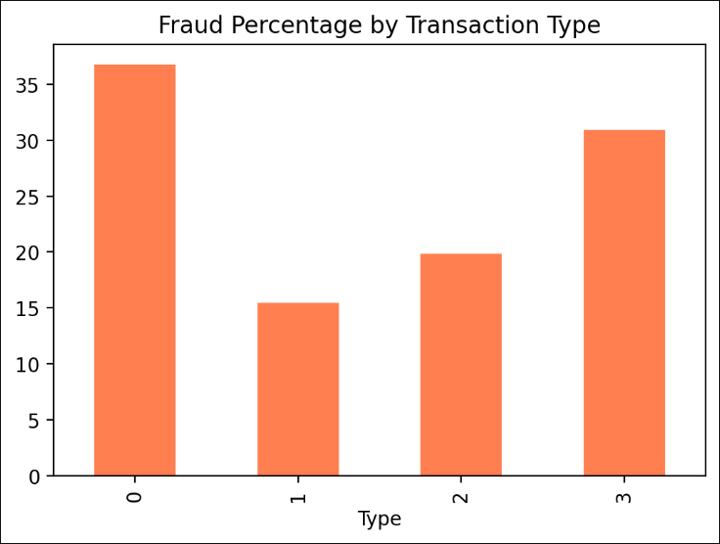
Fraud Rate by Transaction Type: ATM and Bank Transfer transactions show higher fraud percentage.
X-axis values (encoded): 0 = ATM, 1 = Card, 2 = Online, 3= Bank Transfer | Y-axis: Fraud Rate (%).

Slide 12
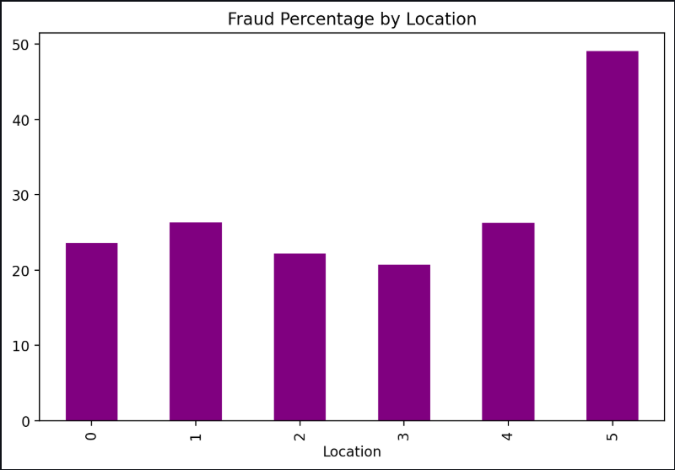
Fraud Rate by Location: “Unknown” locations show a much higher fraud rate.
X-axis values (encoded): 0 = Delhi, 1 = Mumbai, 2 = Chennai, 3 = Kolkata, 4 = Bangalore, 5 = Unknown | Y-axis: Fraud Rate (%).

Slide 13
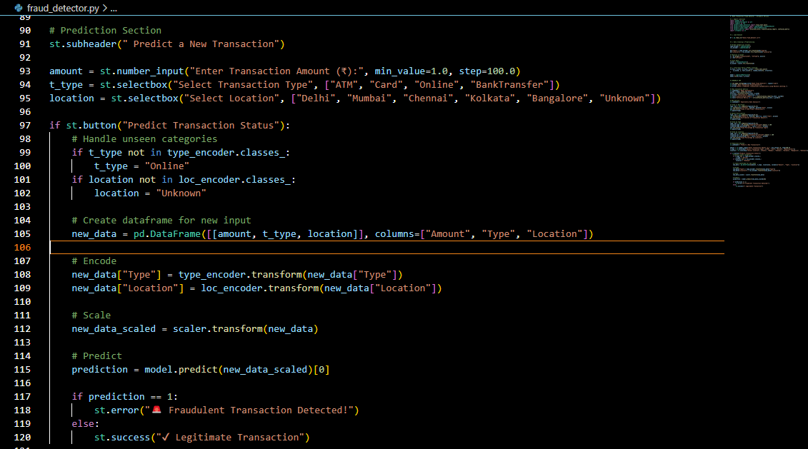
Prediction Section Code
Streamlit code for building the fraud detection interface with user inputs and prediction output

Slide 14
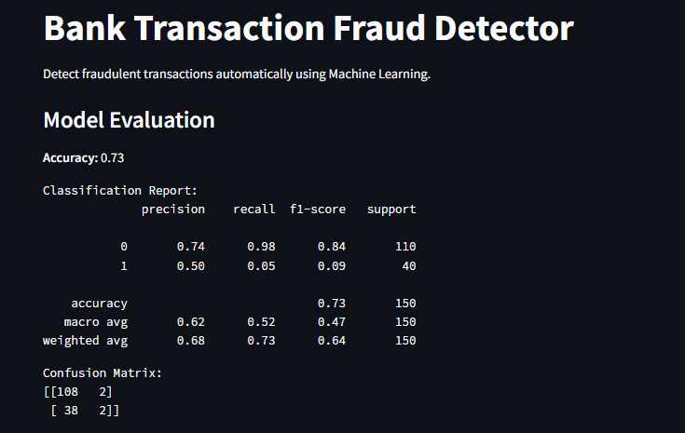

Slide 15
Prediction Demo
Input Example:
- Amount: 12345
- Type: ATM
- Location: Delhi
Output:
- Legitimate Transaction

Slide 16
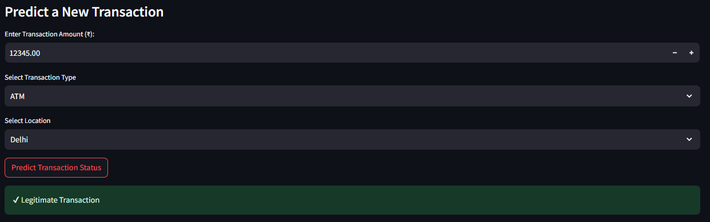

Slide 17
Conclusions
• Built an intelligent fraud detection model.
• Achieved ~80% accuracy on synthetic dataset.
• Real-time predictions using Streamlit
• Helps protect banks and customers from fraud.

Slide 18
GitHub & Download Links
GitHub Repository:
https://github.com/SY221204/Bank-Transaction-Fraud-Detector
Sample CSV File:
Bank_fraud_dataset.csv

